Slide 1

MBAX 6418
Context Engineering and RAG
David Dobolyi, PhD
Assistant Professor
Stone Family Faculty Scholar
david.dobolyi@colorado.edu

Slide 2
Topics
Context Engineering
Retrieval Augmented Generation (RAG)
Building a RAG System
Class Exercise
2

Slide 3
Context Engineering

Slide 4
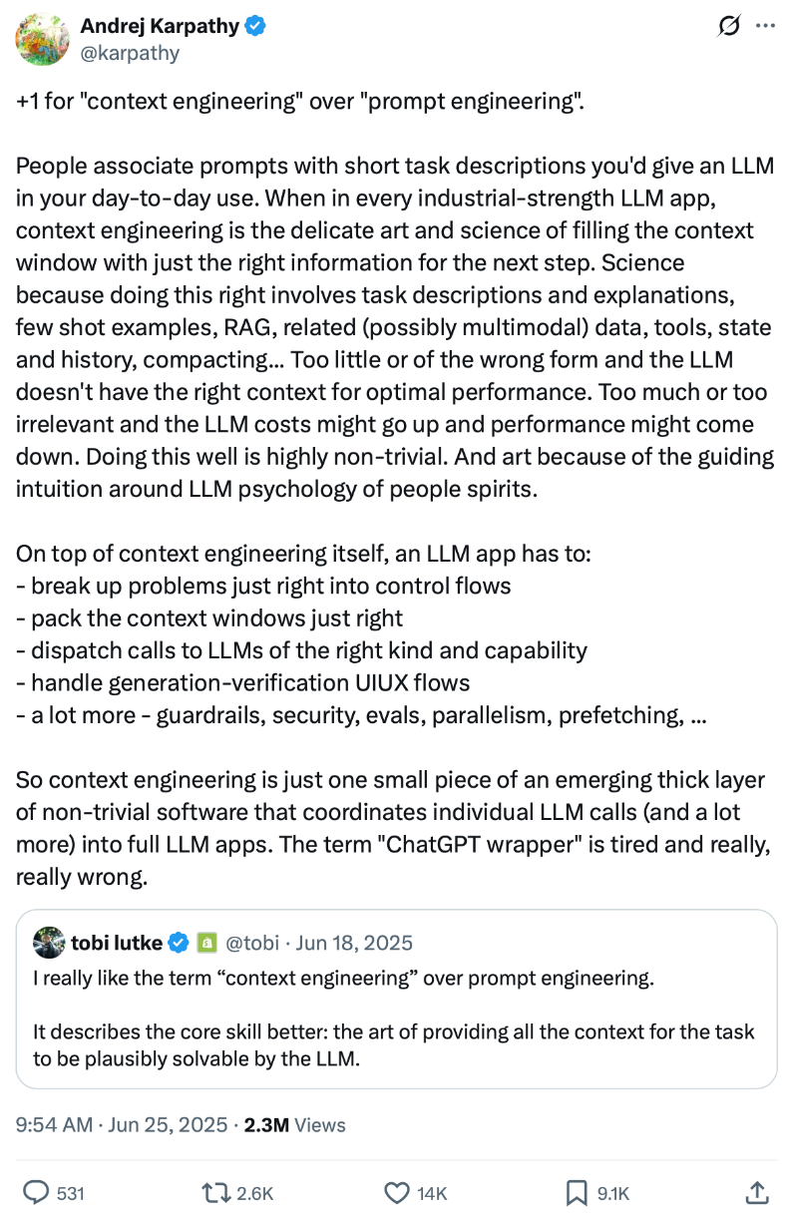
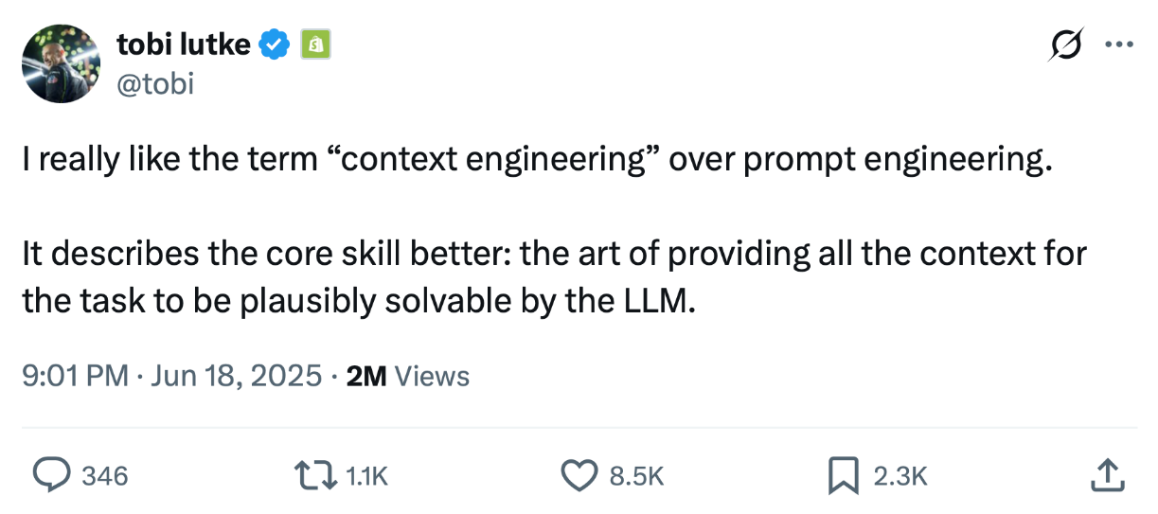

From Prompts to Context
Notes:
Sources:
https://x.com/tobi/status/1935533422589399127
https://x.com/karpathy/status/1937902205765607626

Slide 5
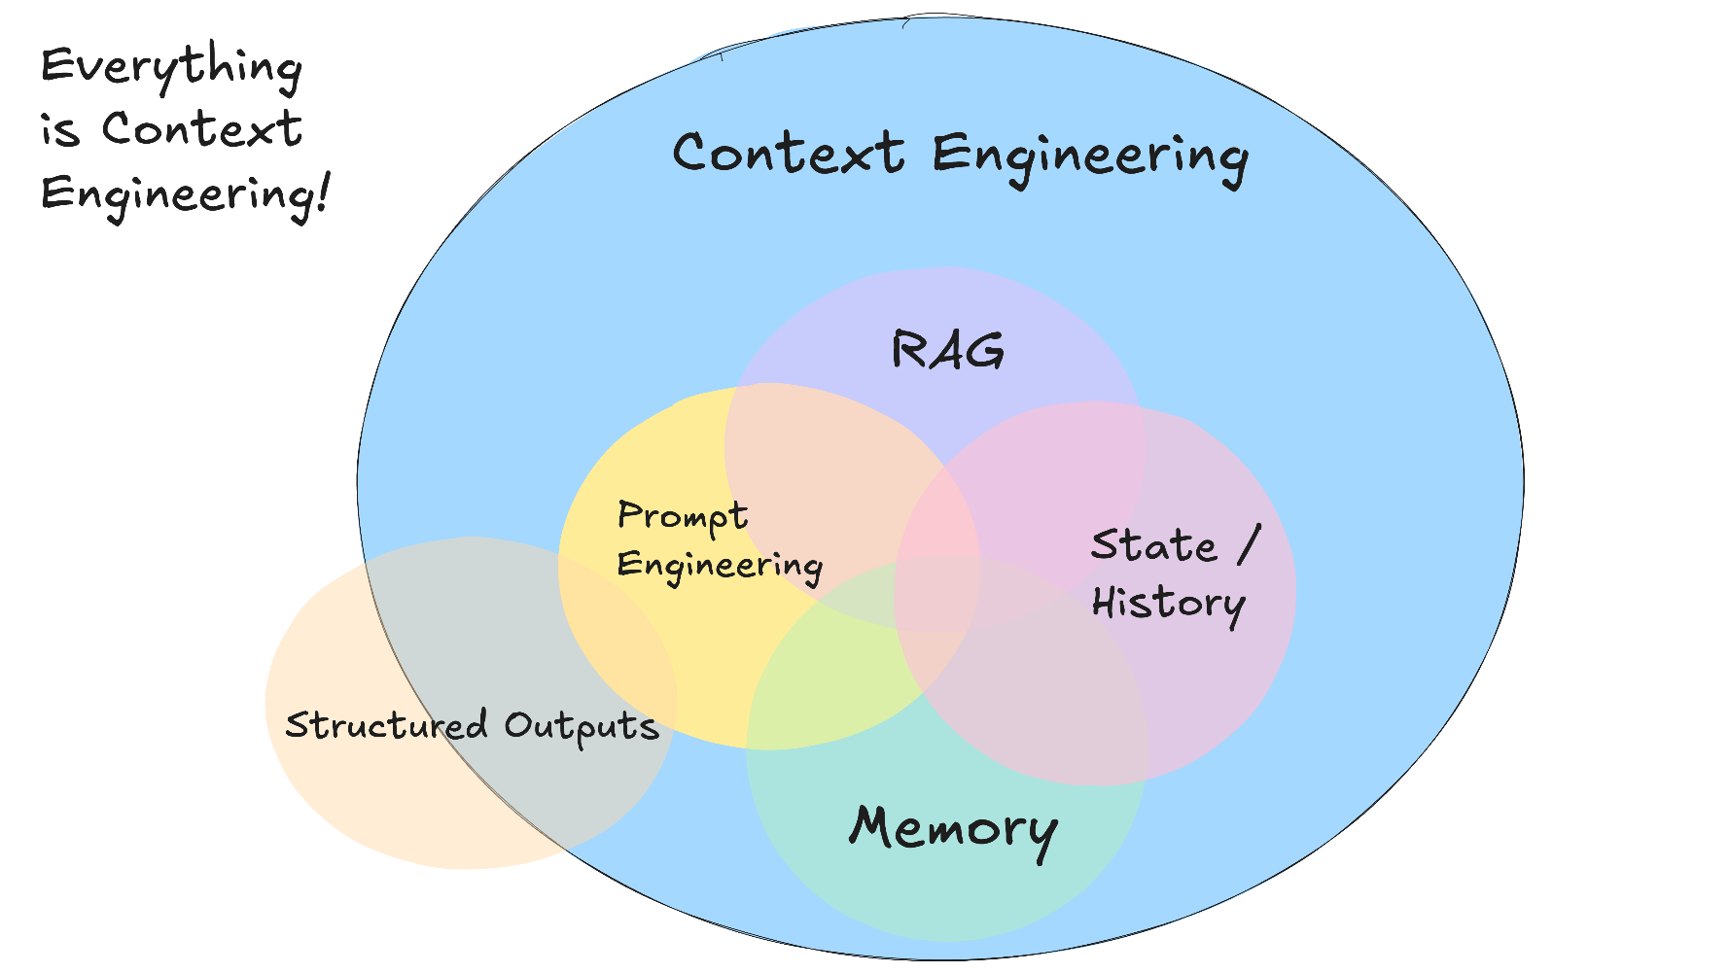
But What Is Context Engineering?
Notes:
Sources:
https://github.com/humanlayer/12-factor-agents/blob/main/content/factor-03-own-your-context-window.md

Slide 6
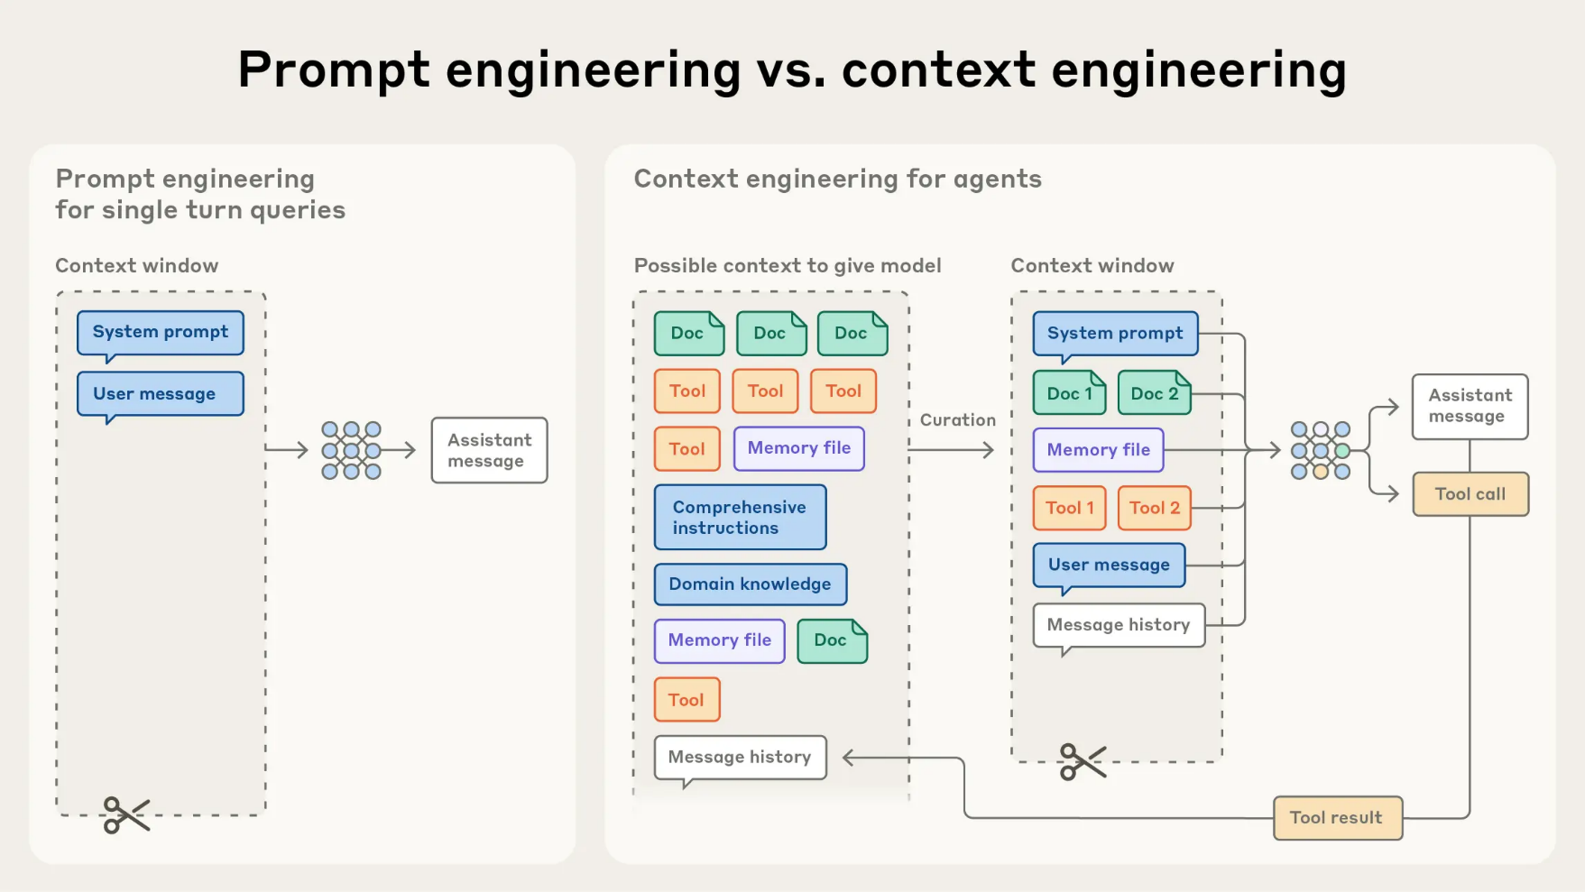
Expanding the Scope
Notes:
Sources:
https://www.anthropic.com/engineering/effective-context-engineering-for-ai-agents

Slide 7
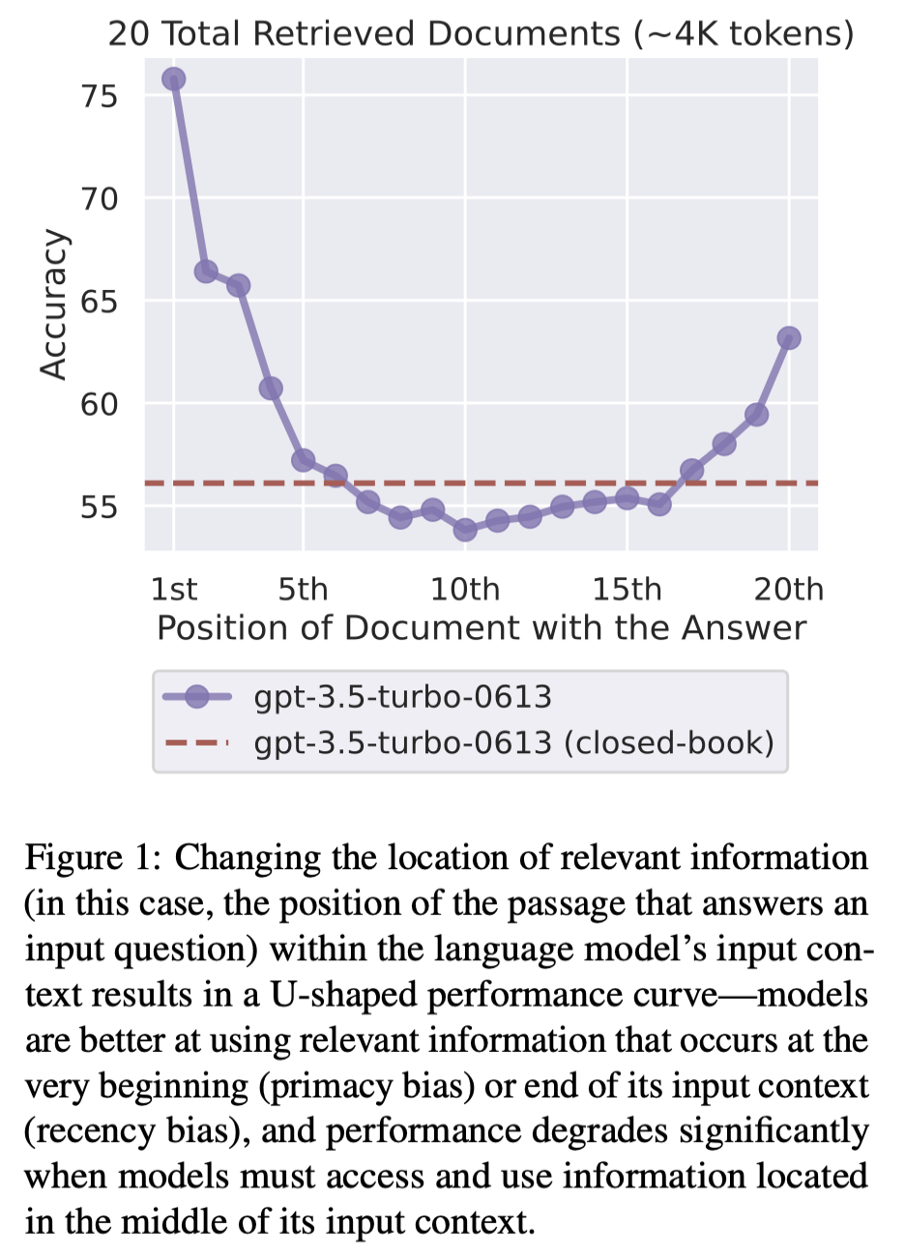
Context Location Matters?
Historically, models suffered from a Lost in the Middle (LITM) effect: LLM accuracy dropped when relevant facts occurred in the middle of input context (Liu et al. 2023)
Some newer models are more resistant to this effect, but performance still depends on the model, task, and/or surrounding content (e.g., McKinnon 2025; Zhang et al. 2026)

Slide 8

Context Is Not Infinite
Even very large context windows can fill up during long-running or complex tasks
Older information may need to be removed or summarized
Agent harnesses (e.g., Hermes) can manage this for you automatically
But what about context engineering for apps you create?
Notes:
Sources:
https://claude.com/blog/context-management
https://www.youtube.com/watch?v=BER3EhUIyz0

Slide 9
Retrieval Augmented Generation (RAG)

Slide 10
What Is RAG?
Retrieval-augmented generation (RAG) retrieves relevant information from documents, databases, and other data sources and adds it to a model’s context to help generate a response to a user’s prompt/question
Notes:
Sources:
https://learn.microsoft.com/en-us/azure/databricks/agents/retrieval-augmented-generation
https://arxiv.org/abs/2005.11401

Slide 11
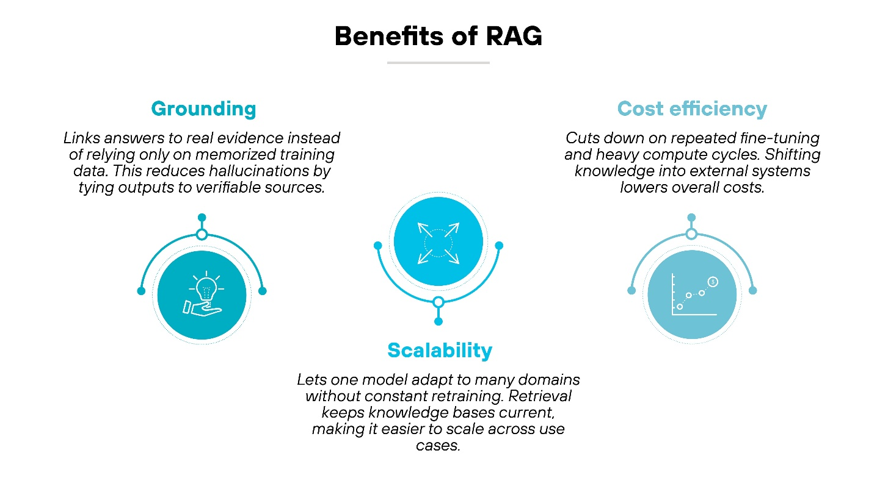
Why Use RAG?
RAG gives a model access to information beyond its training data, including more recent or private information
It selects relevant material from a large collection – or corpus – and grounds responses in sources, making answers easier to verify, potentially reducing hallucinations
Notes:
Sources:
https://www.paloaltonetworks.com/cyberpedia/what-is-retrieval-augmented-generation

Slide 12
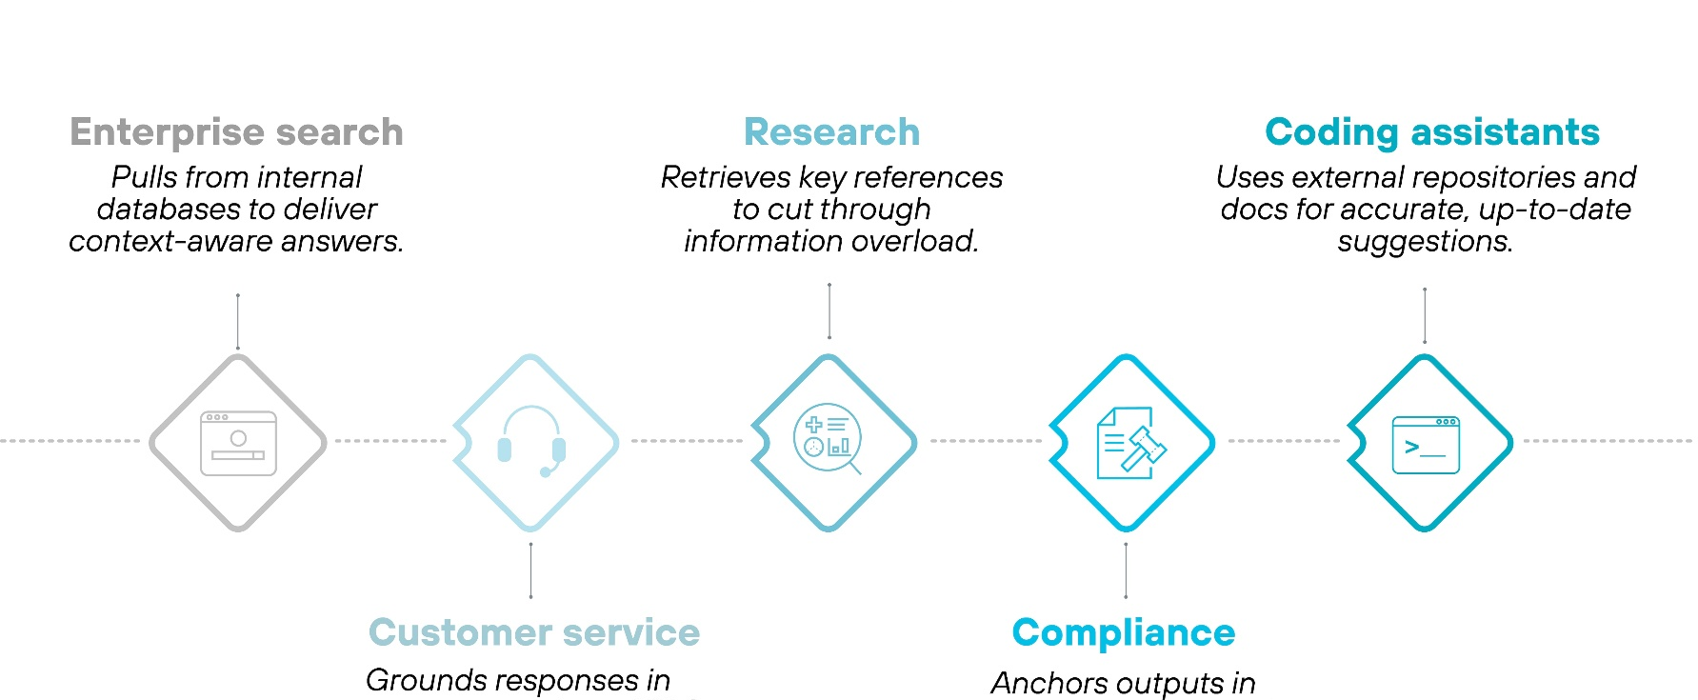
RAG Use Cases
RAG lets your app draw on codebases, course materials, private documents, and other information sources to support a variety of tasks
Notes:
Sources:
https://www.paloaltonetworks.com/cyberpedia/what-is-retrieval-augmented-generation

Slide 13
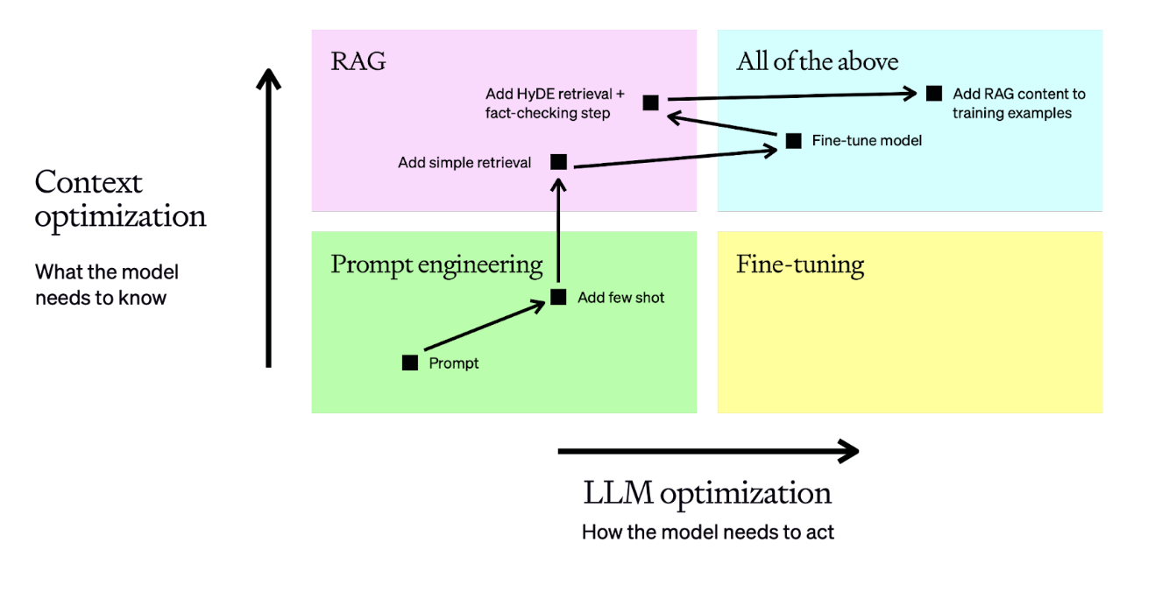
Context Optimization
RAG optimizes context by supplying relevant information when the model responds
Fine-tuning adapts the model itself through additional training—a topic we’ll cover later
Notes:
Sources:
https://developers.openai.com/api/docs/guides/optimizing-llm-accuracy#retrieval-augmented-generation-rag

Slide 14
Building a RAG System

Slide 15
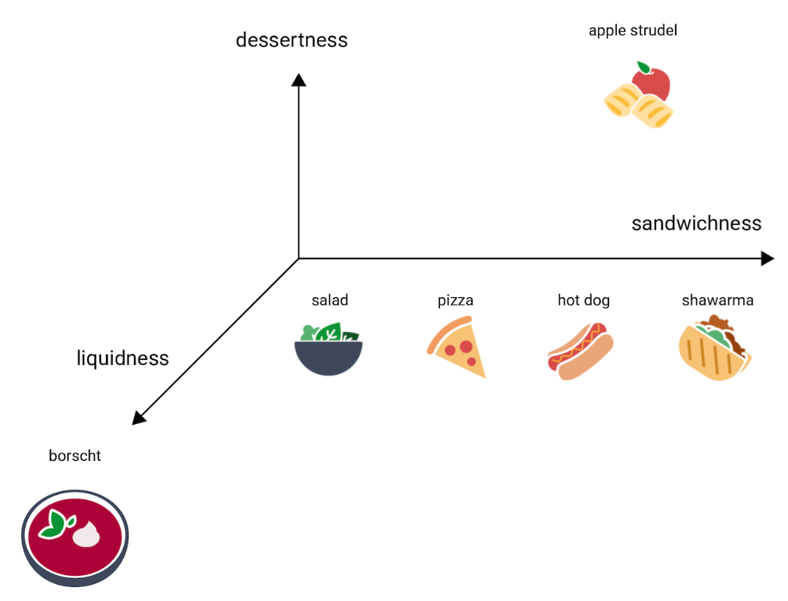
Semantic Search and Embeddings
RAG often uses semantic search, or search based on meaning, to retrieve info relevant to the user’s question
Semantic search typically uses embeddings to numerically represent text, images, and other data
Embeddings are like coordinates
in high-dimensional space: similar
items tend to lie closer together
Vector search compares the question’s embedding with data embeddings to find potential matches
Notes:
Sources:
https://developers.google.com/machine-learning/crash-course/embeddings/embedding-space

Slide 16
Preparing Documents (Docs) for Search
Docs added or updated in the RAG corpus must be prepared for search
Parsing extracts text and structure from each doc
Chunking divides the parsed content of each doc into useful passages while preserving source metadata (e.g., doc name, page number)
Indexing prepares the chunked passages for both:
  Keyword (lexical) search to find chunks containing matching words
  Vector search, which uses embeddings to find chunks with similar meanings

Slide 17
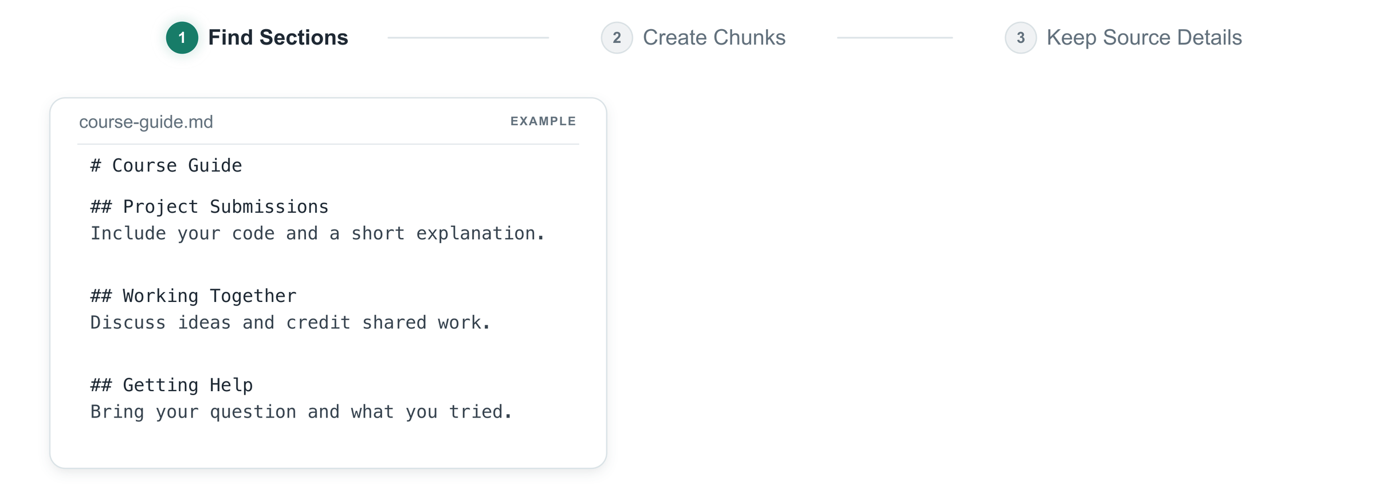
Chunking: How Much Context Is Enough?
Each chunk should contain just enough context to be useful in isolation
Common chunking strategies:
  Fixed size – chunks with a set size, often with overlap
  Recursive – split at boundaries like paragraphs, then divide oversized chunks at finer boundaries like sentences
  Document-based – keep related information together based on structural boundaries such as headings (see example above)
  Semantic – split based on changing topics or meanings

Slide 18
Hybrid RAG Pipeline with Reranking
RAG uses information from prepared documents to help an LLM answer the user’s question
Retrieval finds relevant candidate chunks using both keyword search and vector search in Hybrid RAG
Reranking compares these candidates to the original question and prioritizes which chunks are supplied to the LLM as context

Slide 19
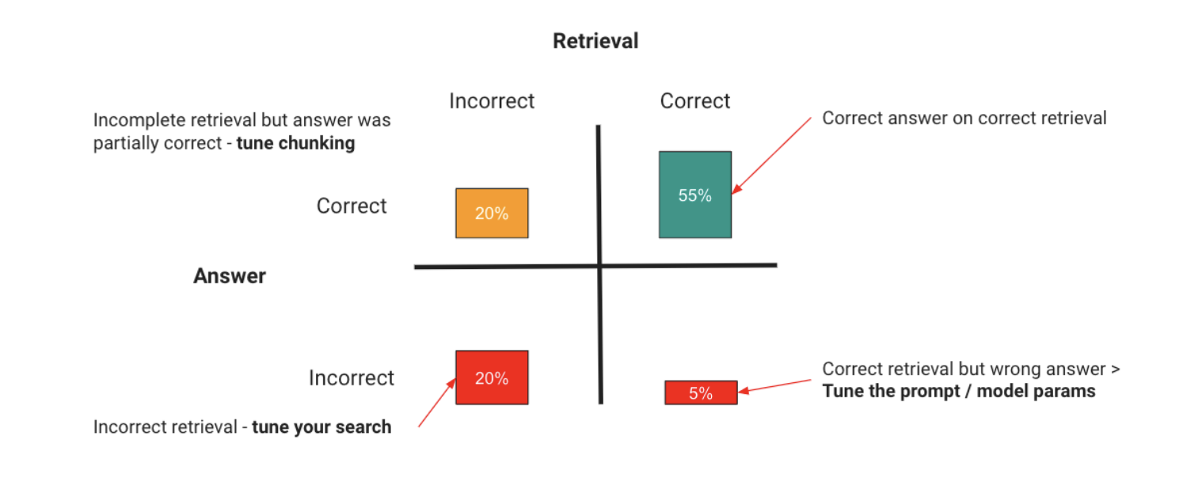
Accurate RAG is Challenging
Accurate RAG requires checking both retrieval quality and answer accuracy using questions relevant to your app
Use the MTEB Leaderboard to shortlist retrieval models and then test them on your own documents and questions
Notes:
Sources:
https://developers.openai.com/api/docs/guides/optimizing-llm-accuracy#retrieval-augmented-generation-rag

Slide 20
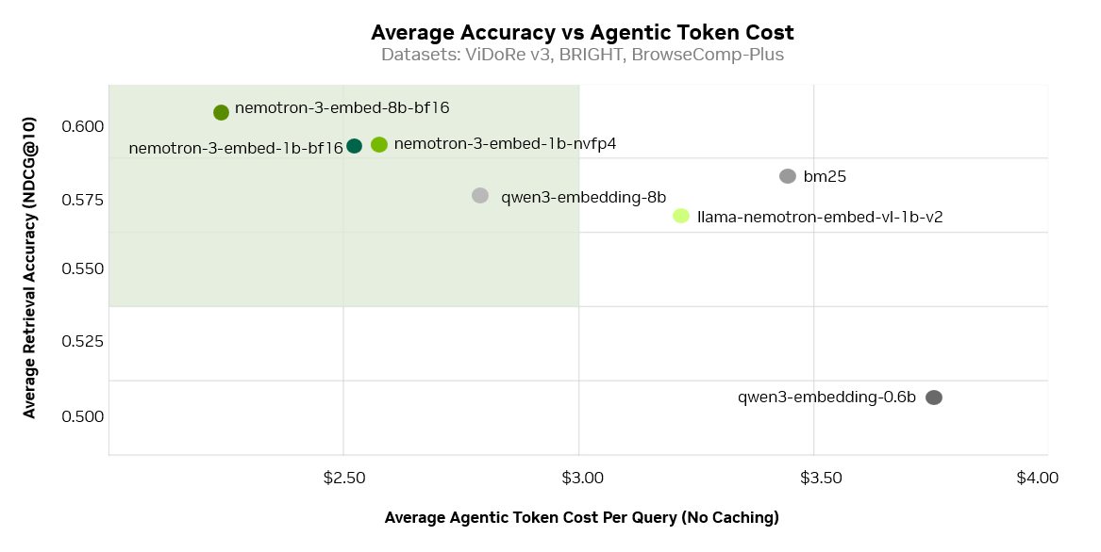
RAG Done Right Can Be Valuable
Retrieving relevant evidence early can reduce tokens spent processing irrelevant information, repeating searches, and performing unnecessary reasoning – and this can save money, improve efficiency, etc.
Notes:
Sources:
https://huggingface.co/blog/nvidia/nemotron-3-embed-wins-rteb

Slide 21
Class Exercise

